Slide 1

An Online Shopping System
Name : Saidathu Nisa
Submission date : 09/09/2024

Slide 2

AIM OF PROJECT
Manage products by allowing admins to add remove and update items in the store.
Provide customers with an easy to use platform to browse and purchase products.
Simulate a smooth checkout process with order confirmation and address management.
Store and manage customer information including names and shipping address.
Use an object oriented design to make the system scalable and easy to extend with new features.

Slide 3


PROBLEM STATEMENT
Limited accessibility
Insufficient search and navigation
Poor user experience
Shipping and delivery issues
Customer support challenges

Slide 4
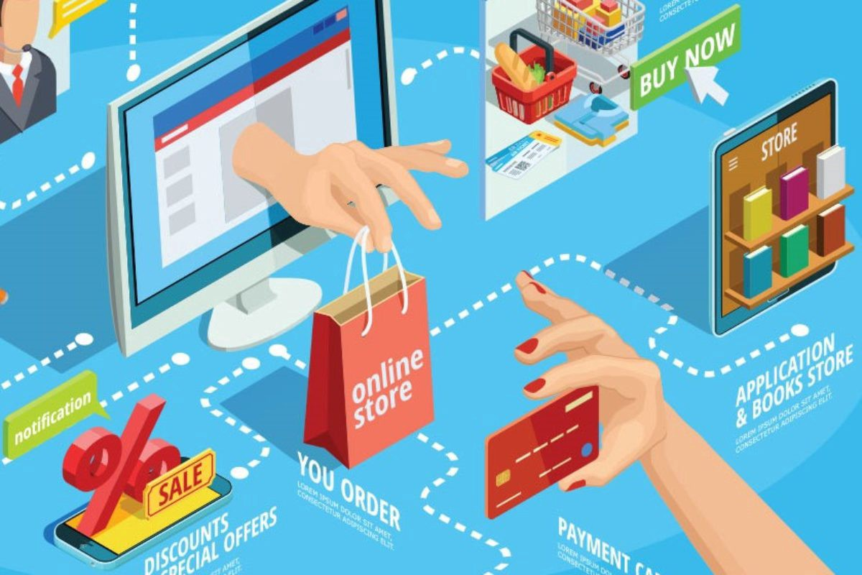
PROJECT DESCRIPTION
METHODOLOGIES USED FOR THE PROJECT
1. Object- oriented programming
2. Modular design
3. Design patterns
4. Model view controller
5. Data persistence
SCOPE OF THE PROJECT
E-Commerce simulation
Oop principles
Modularity
User interaction
KEY FEATURES
1. User Registration and authentication.
2. Product Catalog.
3. Shopping Cart
4. Order Processing , Order history and Tracking
5. Payment Gateway , Admin Features
6. Error Handling

Slide 5


FUNCTIONS
Allows users to create accounts log in and log out securely. Ensures proper user management icludung profile updates and password resets
Handles the addition update and removal of products . provides features for categorizing products ,selling prices and managing stock availability.
Allows user to add , update or remove products in their virtual cart. calculates the total cost dynamically as products are added or removed.
Manages the process of placing orders including checkouts , payment processing and generating order summaries or receipts.
Provides searche fuctionality for users to easily find products by keywords , categories,or filters.(eg..price,rating,availability)
Facilitates secure payment method like credit card , debit card, or digital wallets

Slide 6


INPUT VERSATILITY AND ERROR HANDLING
The system should be able to handle a variety of inputs users, whether they are entering product information, payment details, or login credentials. The system should anticipate different forms of valid inputs and respond correctly. Key aspects of input versatility include:
User Registration Inputs
Product Search
Payment Information
Order Quantity Input

Slide 7
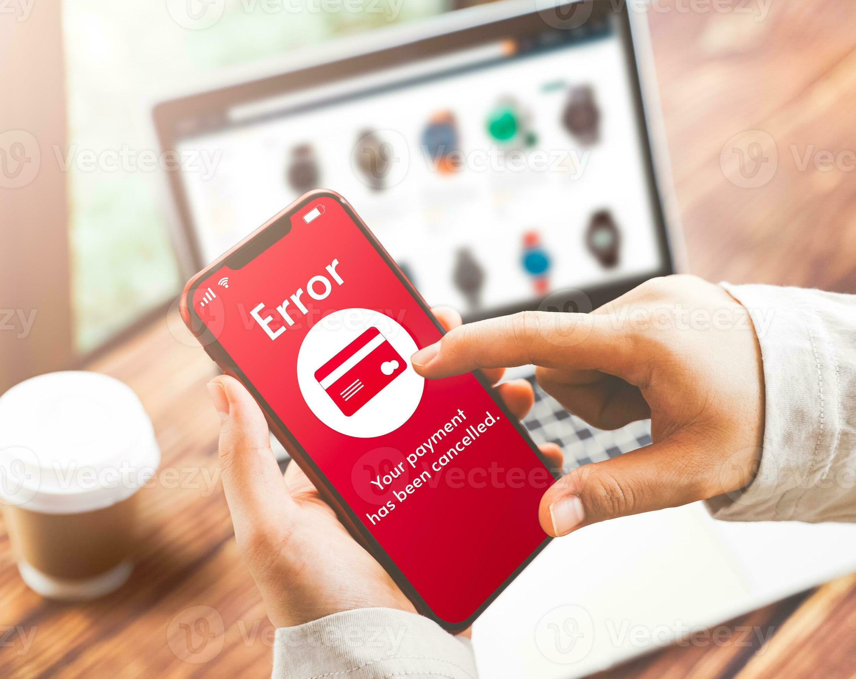
ERROR HANDLING
The system needs to gracefully handle incorrect or unexpected inputs. Here are some common error scenarios and how the system might handle them:
1.Incorrect Login Details
2. Product Not Found
3. Invalid Payment Details
4. Invalid Cart Quantity

Slide 8
CODE IMPLEMENTATION
In an online shopping system implemented using Object-Oriented Programming (OOP), key features such as user authentication, cart management, payment processing, and order handling can be structured into classes that represent entities in the system. Below is a detailed explanation of how such a project can be implemented, including insights into key algorithms, data structures, and code organization.
Classes
Product
Cart
Order
Payment

Slide 9
RESULTS AND OUTCOMES
The online shopping system project aimed to streamline and automate the shopping experience for users and businesses. Below are the key results achieved:
Improved User Experience
Efficient Order Management
Inventory Management
Payment Gateway Integration
Increased Sales & Customer Engagement
Scalability

Slide 10
CONCLUSION
The implementation of the online shopping system has successfully transformed the shopping experience for both customers and businesses. By automating various processes such as order management, inventory tracking, and payment handling, the system has significantly improved efficiency, reduced operational costs, and minimized human errors.
The project has achieved its primary goals of streamlining the purchasing process, enhancing customer satisfaction, and boosting sales. Feedback from users has been overwhelmingly positive, with high satisfaction rates attributed to the ease of use and secure transaction protocols. Additionally, the system has provided valuable insights into consumer behavior, allowing businesses to make data-driven decisions regarding marketing strategies and inventory management. The scalability of the system ensures that it can accommodate growth in both user numbers and transaction volumes without performance issues.

Slide 11



Photo Collage
THANK YOU

